Slide 1
Laplacian Bayesian Matting Comparison
Matting Based on Bayesian and Laplacian Algorithm
Lingyu Gong, Changhong Li, Qiwen Tan
E3 School
Date 27/02/2024

Slide 2

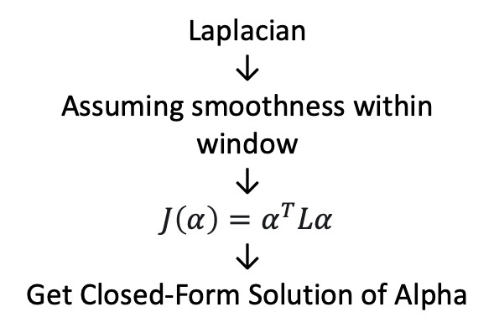
Algorithm
Mathematical Comparison
$$C=αF+(1−α)B$$
↓
Unsolvable
Laplacian
↓
Assuming smoothness within window
↓
$J\left(α\right)=α^{T}Lα$
↓
Get Closed-Form Solution of Alpha
Bayesian
↓
Maximum Likelihood
↓
Estimate F and B
↓
Calculate Alpha

Slide 3
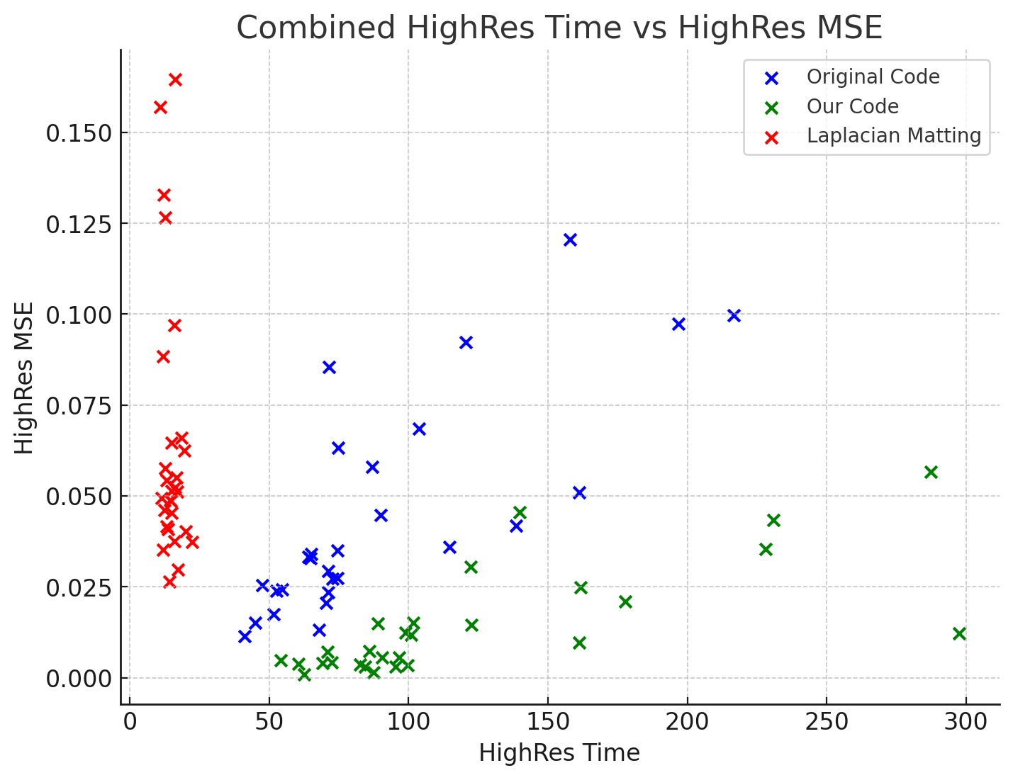
Result
High Resolution
For high-resolution images, our code consistently achieves a lower MSE for both simple and complex images.

Slide 4
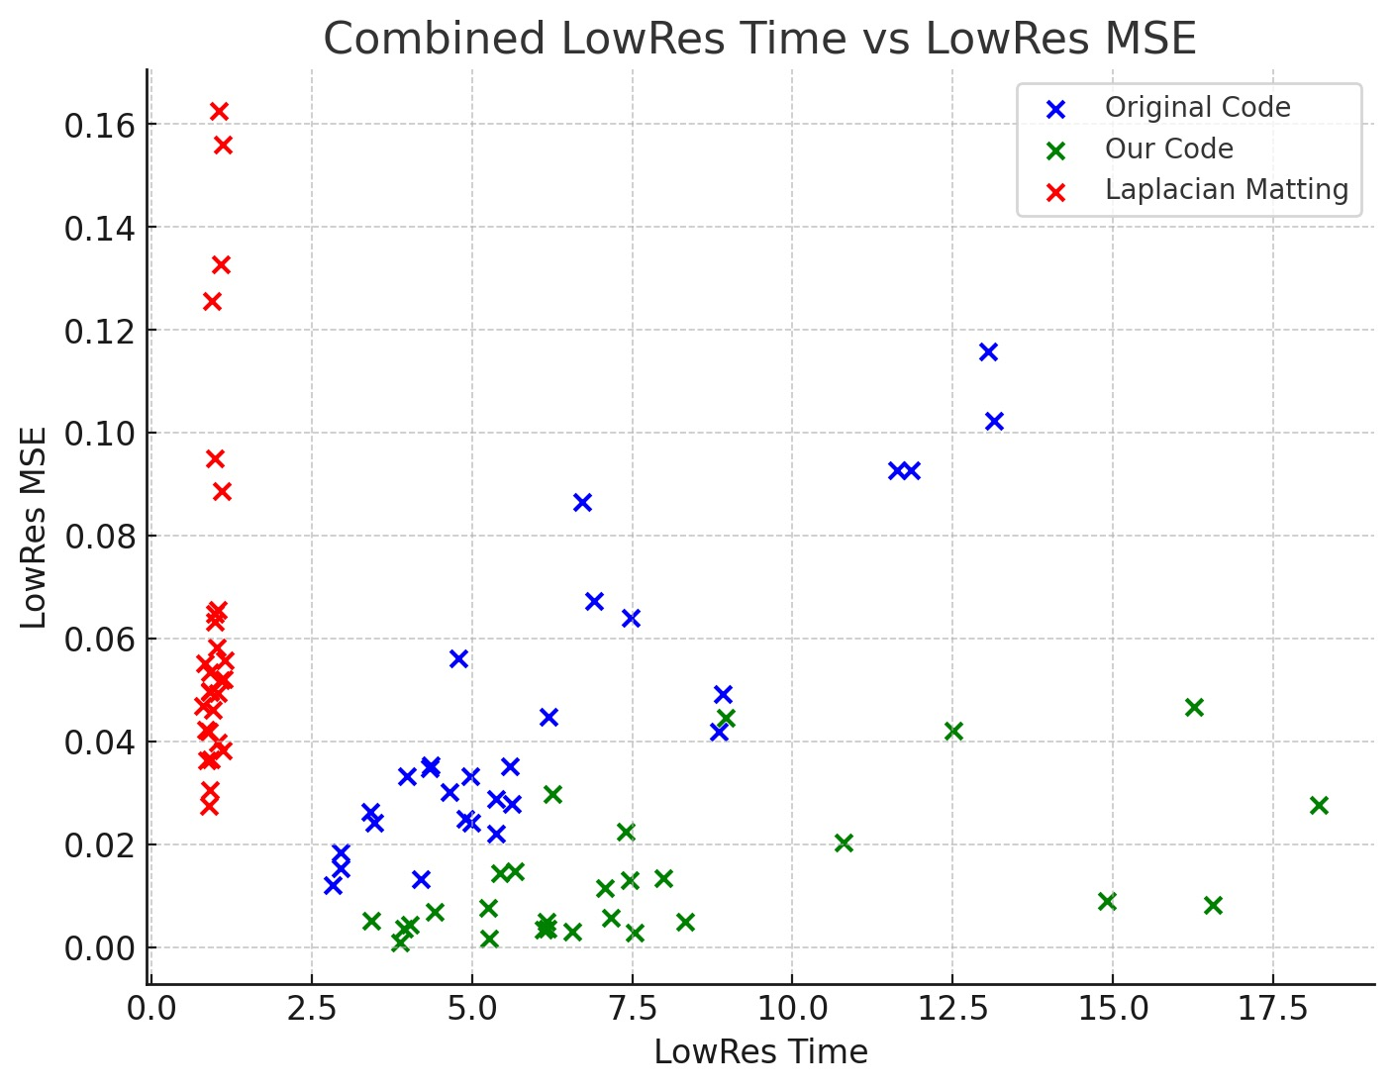
Result
Low Resolution
Similarly, for low-resolution images, our code also has a superior advantage in terms of MSE.

Slide 5
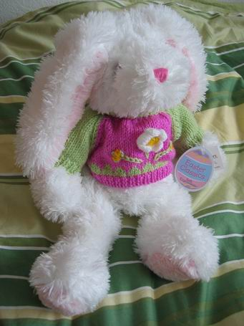
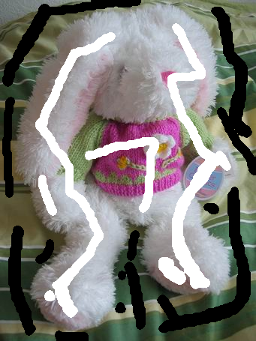
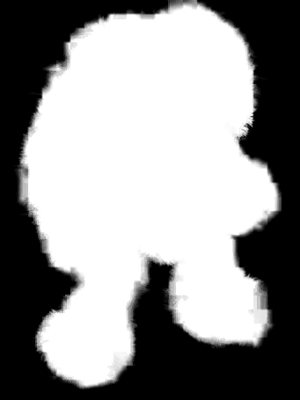
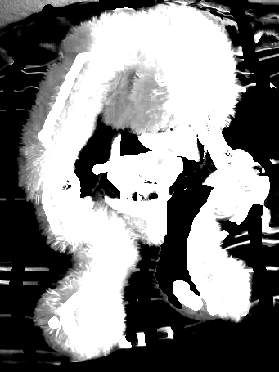
Result
Advantage of Laplacian Matting Algorithm
Original Image
Trimap
Laplacian
Bayesian

Slide 6
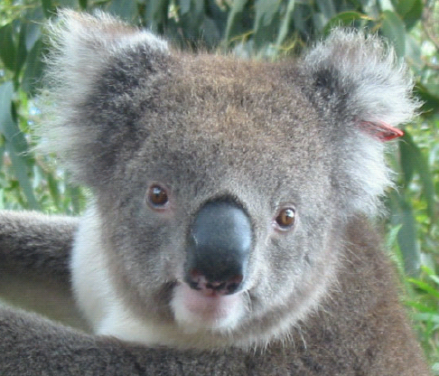
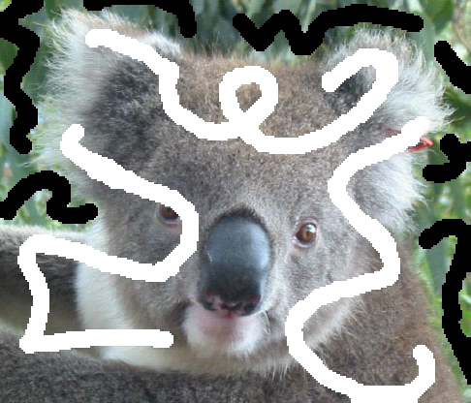
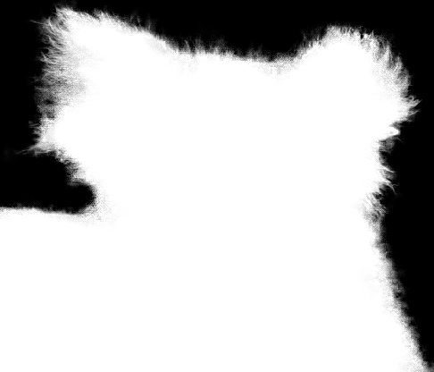
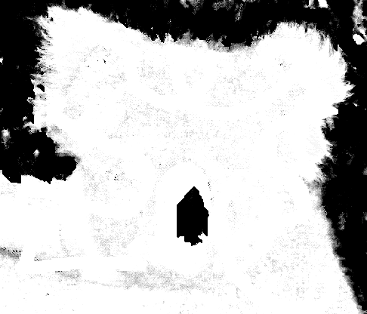
Result
Advantage of Laplacian Matting Algorithm
Original Image
Trimap
Laplacian
Bayesian

Slide 7
Result
Processing Time Comparison
High-Resolution Image
Our code has an average processing time of 232.51 seconds.
Compared to the original code (170.82 seconds), our code has a 36.11% increase in processing time.
Compared to the Laplacian Matting method (28.43 seconds), our code has a significant increase in processing time of 718.01%.
Low-Resolution Image
Our code has an average processing time of 15.15 seconds.
Compared to the original code (11.75 seconds), our code has a 28.98% increase in processing time.
Compared to the Laplacian Matting method (1.86 seconds), our code has a significant increase in processing time of 715.20%.

Slide 8
Result
MSE Comparison
High-Resolution Image
Our code has an average MSE of 0.0145.
Compared to the original code (0.0447), our code has a 67.58% reduction in MSE.
Compared to the Laplacian Matting method (0.0646), our code has a 77.58% reduction in MSE.
Low-Resolution Image
Our code has an average MSE of 0.0134.
Compared to the original code (0.0447), our code has a 70.01% reduction in MSE.
Compared to the Laplacian Matting method (0.0648), our code has a 79.32% reduction in MSE.

Slide 9
Result
Conclusion
Time: Our code, due to the use of a larger number of functions, may have taken some extra time in data retrieval, leading to a significant increase in processing time when compared to both the original code and the Laplacian matting algorithm.
MSE: Thanks to our improved algorithm for calculating the average alpha of a central pixel based on surrounding pixels, our MSE is lower for both complex images (which take longer to process) and simple images (which take less time to process). This effect is particularly evident when compared with the Laplacian matting algorithm.
However, the advantage of the Laplacian matting algorithm lies in the fact that, as a closed-form solution, its computation time is significantly reduced, and it only requires a simple trimap for matting. Here, since I do not have the ground truth for the rabbit and koala bear, I am unable to make a mathematical comparison, but even with a visual inspection, it is evident that the Laplacian matting algorithm achieves better results.

